Slide 1
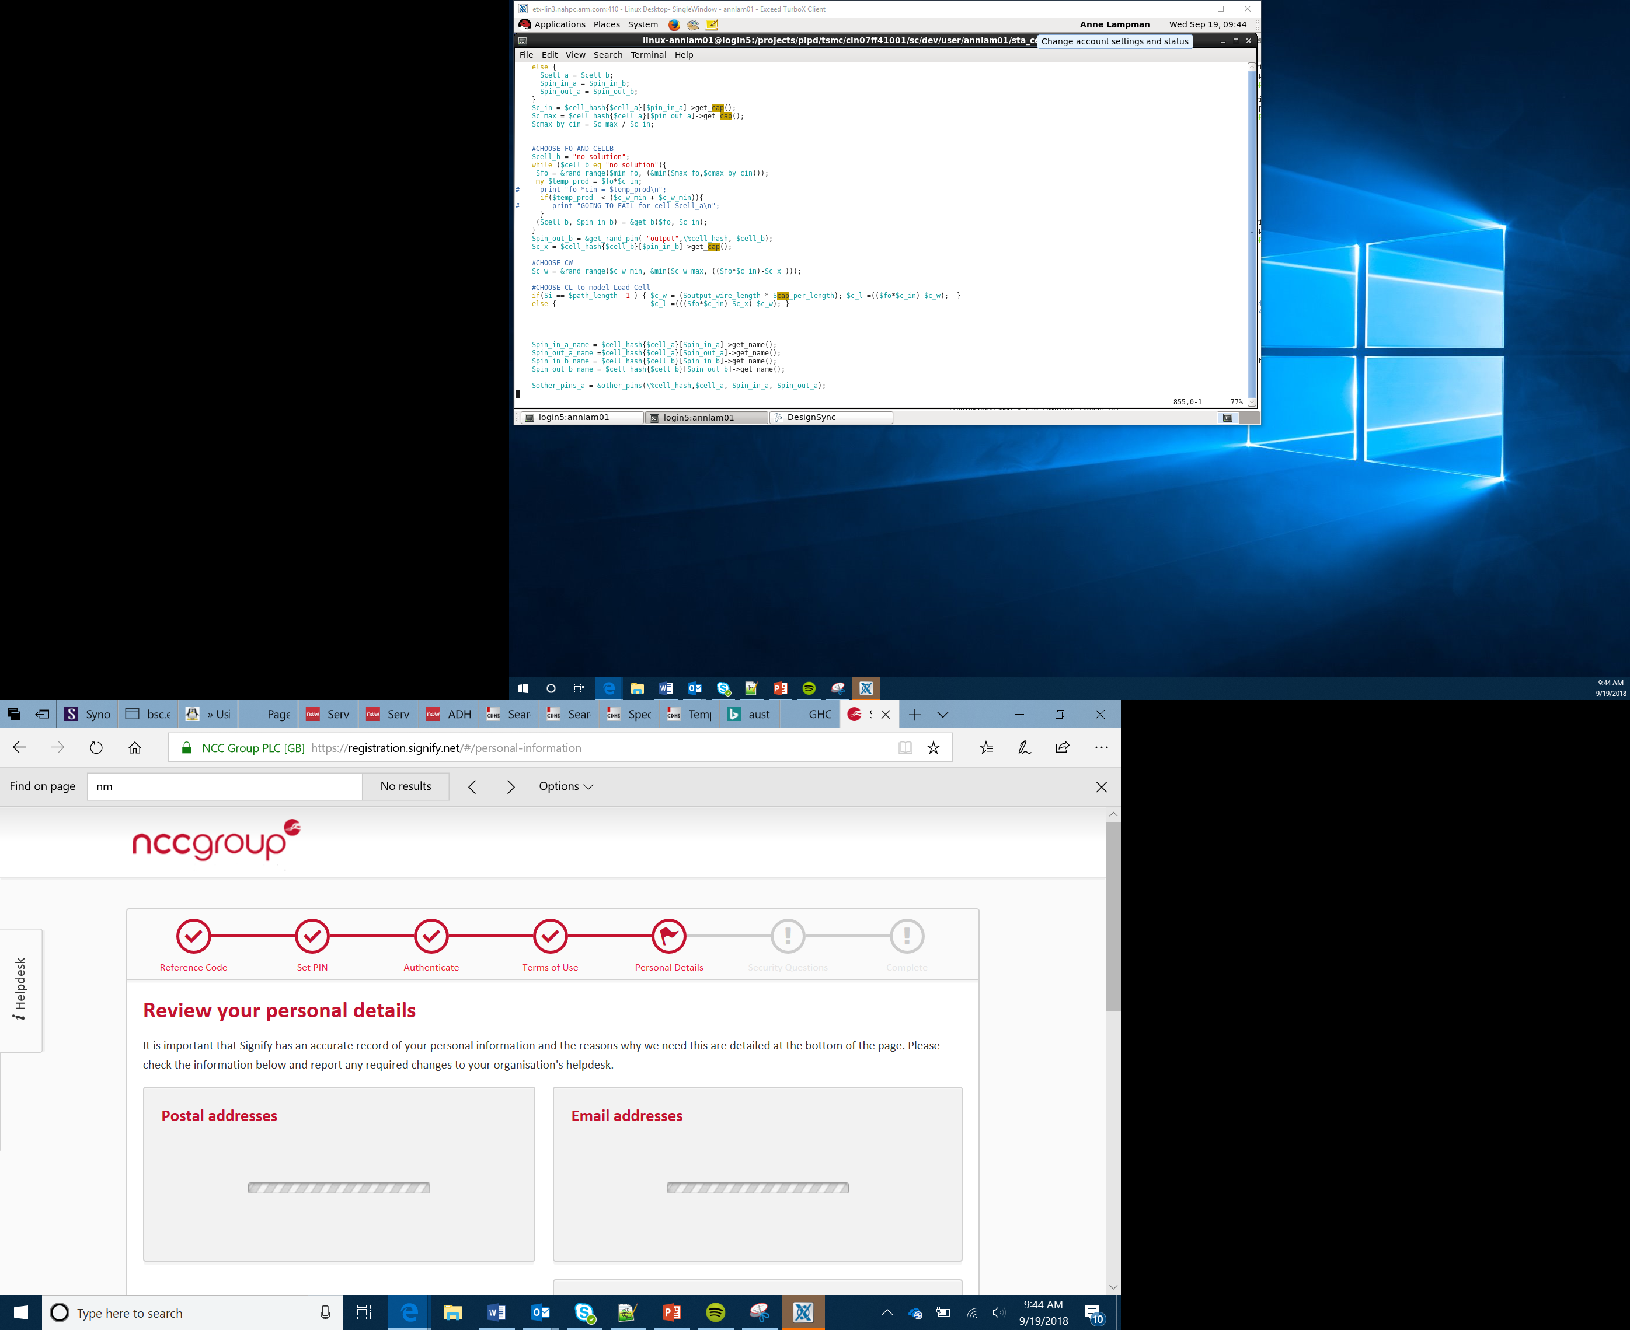

Project – Healthy Eating Quiz Machine
Lesson 5
Planning the Quiz

Slide 2
What You Will Learn
Healthy eating and exercise are an import part of children lives
You have been tasked with creating a digital quiz that asks students about what they eat
They answer a question or questions and the program tells them a score, or a piece of advice, or a food to eat
Notes:
Introduce the project. Discuss healthy and unhealthy foods using examples.

Slide 3
Success Criteria
The product must:
Have a display that the micro:bit is embedded in
Be robust enough to be played with
Contain a micro:bit that users can interact with
Use the buttons to input answers
Provide some feedback to the user, a score, some advice or a food to eat
Notes:
Encourage Learners to jot down ideas as you go through Success Criteria. Explain that Learners could work in groups and could split the tasks between them. Show the Planning sheet and explain what they will do with that first.

Slide 4
Some Ideas
Here are some possible ideas that could be programmed:
Provide instructions
Ask the child a question – this could be on a sheet of paper or scrolled across the micro:bit
Allow them to respond with Button A , B or A and B
Record the answers (variables)
Display a score at the end
Use the overall score to provide a piece of advice
Use an LED to flash if a certain score is reached

Slide 5
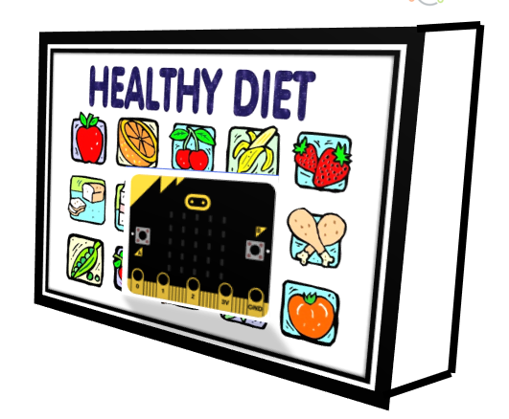
Some Ideas

Slide 6
Pro-tip
Plan the questions, answers and responses first before you start building your program. This will support you to use the correct selection code and responses.
Question 1 – Do you drink more than two cans of pop a day?
A = Yes B = No
Response A = Sad face
Response B = Smile

Slide 7
Plenary
What is going well?
What areas are you struggling with?
Where can you find support or help to resolve these problems.
How is it working as a team?
What one thing do you need to do before next session?
Notes:
Recap and discuss the answers in groups or pairs.
Learners could record their responses.

